Slide 1
RUSTikales Rust for beginners

Slide 2
Plan for today

Slide 3
Plan for today
Recap

Slide 4
Plan for today
Recap
Arrays and Vectors

Slide 5
Recap

Slide 6
Recap
Rust offers many basic types
Integer
Floating Point numbers
boolean
char

Slide 7
Recap
Rust offers many basic types
Integer types in Rust: i8, u8, i16, u16, ..., i128, u128
number → How many bits does the value have?
u is unsigned, i is signed → Negative numbers

Slide 8
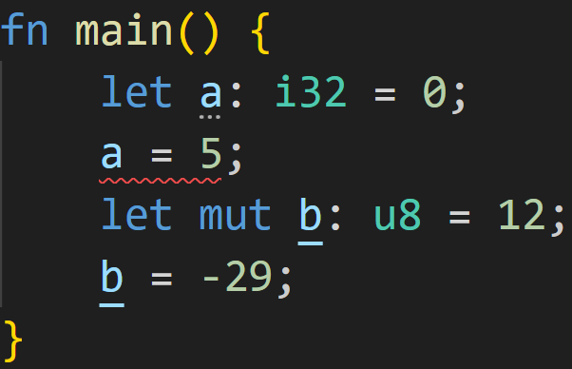
Recap
Rust offers many basic types
Integer types in Rust: i8, u8, i16, u16, ..., i128, u128
let declares an immutable variable
let mut declares a mutable variable

Slide 9
Recap
Rust offers many basic types
Integer types in Rust: i8, u8, i16, u16, ..., i128, u128
let declares an immutable variable
let mut declares a mutable variable
Immutable → Can‘t re-assign to a

Slide 10
Recap
Rust offers many basic types
Integer types in Rust: i8, u8, i16, u16, ..., i128, u128
let declares an immutable variable
let mut declares a mutable variable
Mutable → Can re-assign to b

Slide 11
Recap
Rust offers many basic types
Integer types in Rust: i8, u8, i16, u16, ..., i128, u128
let declares an immutable variable
let mut declares a mutable variable
0/3
Does this work?

Slide 12
Recap
Rust offers many basic types
Integer types in Rust: i8, u8, i16, u16, ..., i128, u128
let declares an immutable variable
let mut declares a mutable variable
0/3
Does this work?
No → u8 is unsigned, can‘t be negative

Slide 13
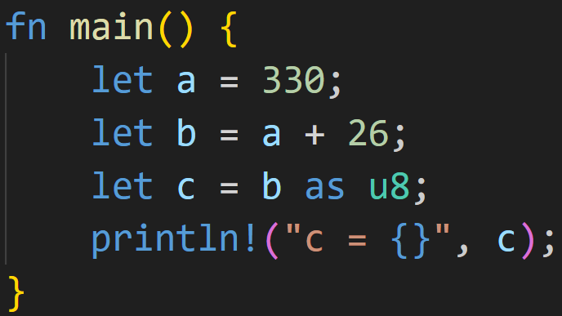
Recap
2/3

Slide 14
Recap
What does the program print in the console?
2/3

Slide 15
Recap
What does the program print in the console?
2/3
a and b are both i32

Slide 16
Recap
What does the program print in the console?
2/3
a and b are both i32
→ b contains 356

Slide 17
Recap
What does the program print in the console?
2/3
a and b are both i32
→ b contains 356
→ 356 does not fit into an u8!

Slide 18
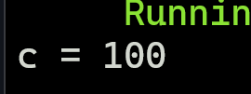
Recap
What does the program print in the console?
2/3
a and b are both i32
→ b contains 356
→ 356 does not fit into an u8!
→ Overflow, c contains 100

Slide 19
Recap
Important to know:
Rust only performs most sanity checks (e.g. Arithmetic Overflow) in Debug mode, not Release mode

Slide 20
Recap
Important to know:
Rust only performs most sanity checks (e.g. Arithmetic Overflow) in Debug mode, not Release mode
Default type for integers is i32

Slide 21
Recap
Important to know:
Rust only performs most sanity checks (e.g. Arithmetic Overflow) in Debug mode, not Release mode
Default type for integers is i32
Integer division truncates the result (rounds toward 0)
Use floats (f32, f64) if decimal digits are important

Slide 22
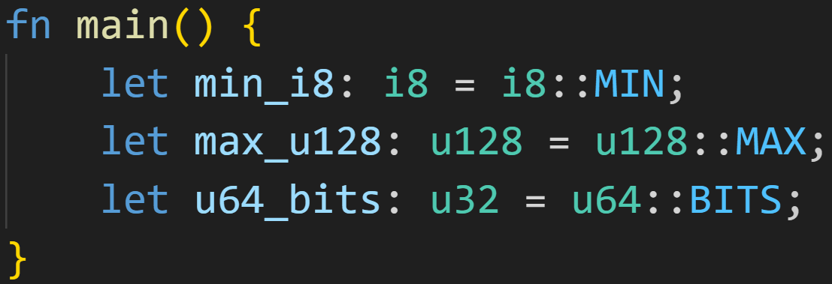
Recap
Important to know:
Rust only performs most sanity checks (e.g. Arithmetic Overflow) in Debug mode, not Release mode
Default type for integers is i32
Integer division truncates the result (rounds toward 0)
Type implementations come with additional constants to make life easier

Slide 23
Recap
Important to know:
Rust only performs most sanity checks (e.g. Arithmetic Overflow) in Debug mode, not Release mode
Default type for integers is i32
Integer division truncates the result (rounds toward 0)
Type implementations come with additional constants to make life easier
Special constant variable defined in another module

Slide 24
Recap
Important to know:
Rust only performs most sanity checks (e.g. Arithmetic Overflow) in Debug mode, not Release mode
Default type for integers is i32
Integer division truncates the result (rounds toward 0)
Type implementations come with additional constants to make life easier
Type limits are bounds, there‘s no way of storing more than that
If your bottle can only hold 2 liters of water, you can‘t fill it with 10 liters → It overflows

Slide 25
Recap
Important to know:
Rust only performs most sanity checks (e.g. Arithmetic Overflow) in Debug mode, not Release mode
Default type for integers is i32
Integer division truncates the result (rounds toward 0)
Type implementations come with additional constants to make life easier
Type limits are bounds, there‘s no way of storing more than that
If your bottle can only hold 2 liters of water, you can‘t fill it with 10 liters → It overflows
Overflows in Programming work slightly different:
Instead of being stuck at 2 liters, it wraps around → Our bottle would contain 10 % 2 = 0 liters of water!
There‘s no physical space for the other bits

Slide 26
Arrays and Vectors

Slide 27
Arrays and Vectors
Arrays and Vectors are collections of values

Slide 28
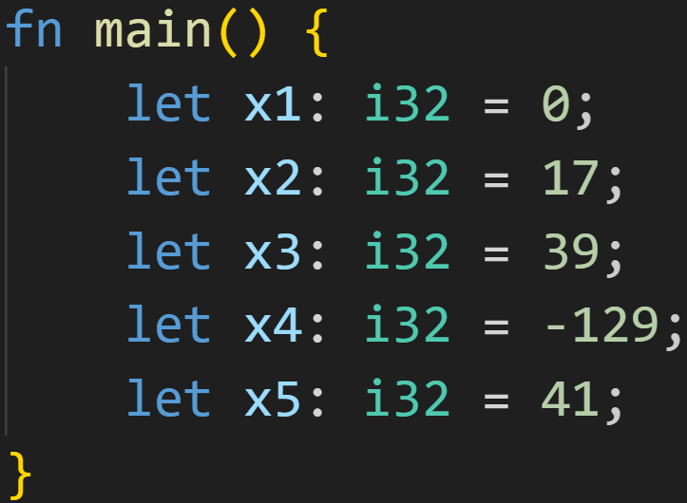
Arrays and Vectors
Arrays and Vectors are collections of values

Slide 29
Arrays and Vectors
Arrays and Vectors are collections of values
A lot of effort, a lot of manual management!

Slide 30
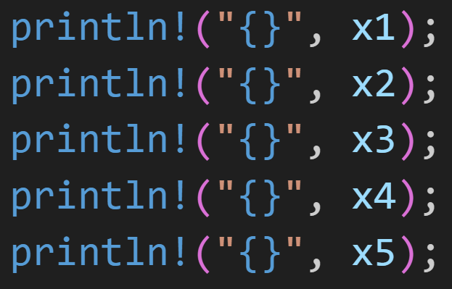
Arrays and Vectors
Arrays and Vectors are collections of values
A lot of effort, a lot of manual management!

Slide 31
Arrays and Vectors
Arrays and Vectors are collections of values
A lot of effort, a lot of manual management!
Now imagine having 1000 x‘s!!

Slide 32
Arrays and Vectors
Arrays and Vectors are collections of values
Introducing: The Array!

Slide 33
Arrays and Vectors
Arrays and Vectors are collections of values
5 elements of type i32
Introducing: The Array!

Slide 34
Arrays and Vectors
Arrays and Vectors are collections of values
Create array using [elem1, elem2, ...]
Introducing: The Array!

Slide 35
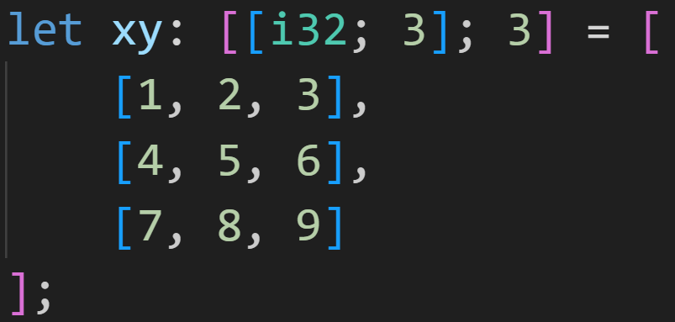
Arrays and Vectors
Arrays and Vectors are collections of values

Slide 36
Arrays and Vectors
Arrays and Vectors are collections of values
Arrays can be nested

Slide 37
Arrays and Vectors
Arrays and Vectors are collections of values
Read: An array of arrays of i32

Slide 38
Arrays and Vectors
Arrays and Vectors are collections of values
3 arrays...

Slide 39
Arrays and Vectors
Arrays and Vectors are collections of values
3 arrays...
of 3 values each

Slide 40
Arrays and Vectors
Arrays and Vectors are collections of values
3 arrays...
of 3 values each...
all of type i32

Slide 41
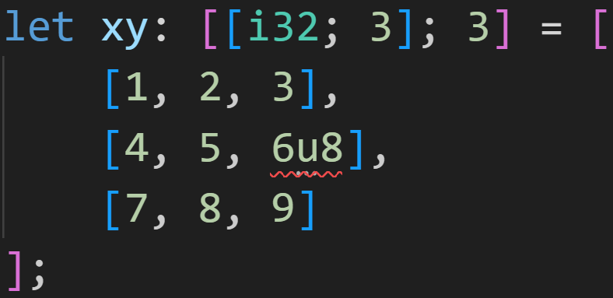
Arrays and Vectors
Arrays and Vectors are collections of values
3 arrays...
of 3 values each...
all of type i32...
Static typecheck catches that!

Slide 42
Arrays and Vectors
Arrays and Vectors are collections of values
Collections of values with the same type

Slide 43
Arrays and Vectors
Arrays and Vectors are collections of values
Collections of values with the same type

Slide 44
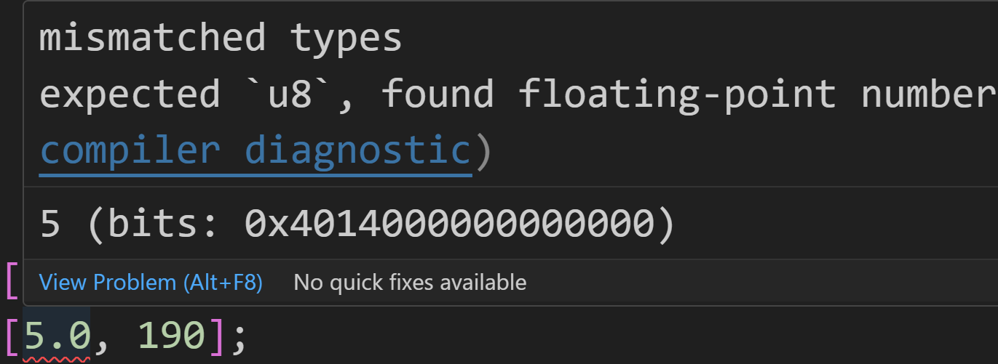
Arrays and Vectors
Arrays and Vectors are collections of values
Collections of values with the same type

Slide 45
Arrays and Vectors
Arrays and Vectors are collections of values
Collections of values with the same type
Arrays have a fixed size, Vectors are resizable

Slide 46
Arrays and Vectors
Arrays and Vectors are collections of values
Collections of values with the same type
Arrays have a fixed size, Vectors are resizable
Array size is specified when declaring them

Slide 47
Arrays and Vectors
Arrays and Vectors are collections of values
Collections of values with the same type
Arrays have a fixed size, Vectors are resizable
Array size is specified when declaring them
Specify directly

Slide 48
Arrays and Vectors
Arrays and Vectors are collections of values
Collections of values with the same type
Arrays have a fixed size, Vectors are resizable
Array size is specified when declaring them
Compiler knows the size of this array, so it can infer the type

Slide 49
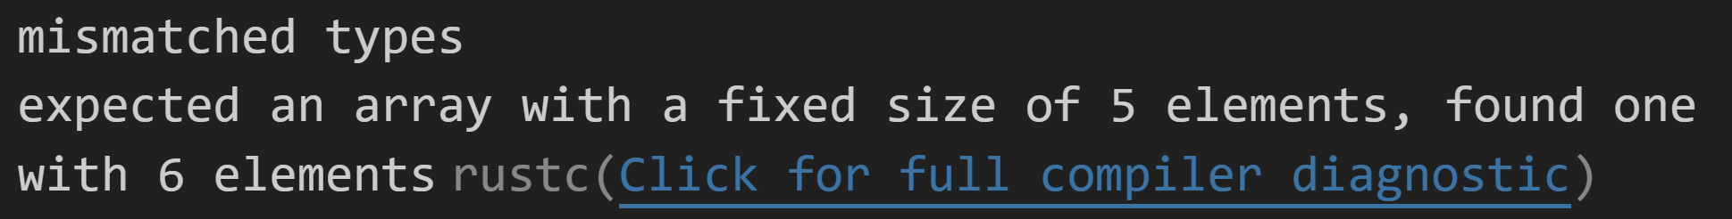
Arrays and Vectors
Arrays and Vectors are collections of values
Collections of values with the same type
Arrays have a fixed size, Vectors are resizable
Array size is specified when declaring them
The compiler will complain if the size doesn‘t match

Slide 50
Arrays and Vectors
Arrays and Vectors are collections of values
Collections of values with the same type
Arrays have a fixed size, Vectors are resizable
Array size is specified when declaring them

Slide 51
Arrays and Vectors
Arrays and Vectors are collections of values
Collections of values with the same type
Arrays have a fixed size, Vectors are resizable
Array size is specified when declaring them
Might take a while to specify 1000 elements...

Slide 52
Arrays and Vectors
Arrays and Vectors are collections of values
Collections of values with the same type
Arrays have a fixed size, Vectors are resizable
Array size is specified when declaring them
Short form: Creates an array of size 1000, and sets each element to 12

Slide 53
Arrays and Vectors
Arrays and Vectors are collections of values
Collections of values with the same type
Arrays have a fixed size, Vectors are resizable
Array size is specified when declaring them
Watch out!

Slide 54
Arrays and Vectors
Arrays and Vectors are collections of values
Collections of values with the same type
Arrays have a fixed size, Vectors are resizable
Array size is specified when declaring them
Vectors have an internal capacity, and are resized automatically when adding too many elements

Slide 55
Arrays and Vectors
Arrays and Vectors are collections of values
Collections of values with the same type
Arrays have a fixed size, Vectors are resizable
Array size is specified when declaring them
Vectors have an internal capacity, and are resized automatically when adding too many elements

Slide 56
Arrays and Vectors
Arrays and Vectors are collections of values
Collections of values with the same type
Arrays have a fixed size, Vectors are resizable
Array size is specified when declaring them
Vectors have an internal capacity, and are resized automatically when adding too many elements
Vector of i32
(Note the <> instead of [])

Slide 57
Arrays and Vectors
Arrays and Vectors are collections of values
Collections of values with the same type
Arrays have a fixed size, Vectors are resizable
Array size is specified when declaring them
Vectors have an internal capacity, and are resized automatically when adding too many elements
Structs and functions will be covered later, but this creates a new Vector for us

Slide 58
Arrays and Vectors
Arrays and Vectors are collections of values
Collections of values with the same type
Arrays have a fixed size, Vectors are resizable
Array size is specified when declaring them
Vectors have an internal capacity, and are resized automatically when adding too many elements
This Vector has a capacity of 0
→ resized the first time you push an element

Slide 59
Arrays and Vectors
Arrays and Vectors are collections of values
Collections of values with the same type
Arrays have a fixed size, Vectors are resizable
Array size is specified when declaring them
Vectors have an internal capacity, and are resized automatically when adding too many elements
This Vector has a capacity of 0
→ resized the first time you push an element
3/3
Why? Seems inefficient...

Slide 60
Arrays and Vectors
Arrays have a fixed size, Vectors are resizable
Array elements are located on the Stack, Vector elements are on the Heap
Vec::new() has a capacity of 0, which means it can‘t store any elements → No heap allocation necessary, more efficient → Only when you add an element, you need Heap memory

Slide 61
Arrays and Vectors
Arrays have a fixed size, Vectors are resizable
Array elements are located on the Stack, Vector elements are on the Heap
Vec::new() has a capacity of 0, which means it can‘t store any elements → No heap allocation necessary, more efficient → Only when you add an element, you need Heap memory
For something to be on the Stack, its size has to be known at compile time → Arrays are fixed size, can‘t add or remove elements

Slide 62
Arrays and Vectors
Arrays have a fixed size, Vectors are resizable
Array elements are located on the Stack, Vector elements are on the Heap
Generally: Stack access is quicker than Heap access

Slide 63
Arrays and Vectors
Arrays have a fixed size, Vectors are resizable
Array elements are located on the Stack, Vector elements are on the Heap
Generally: Stack access is quicker than Heap access
Heap needs to be allocated
Heap may have Pointer-Overhead
Heap needs to be de-allocated

Slide 64
Arrays and Vectors
Arrays have a fixed size, Vectors are resizable
Array elements are located on the Stack, Vector elements are on the Heap
Generally: Stack access is quicker than Heap access
Heap needs to be allocated and de-allocated
For the Stack, those [de-]allocations are builtin and have 0 overhead → More on that when we talk about functions

Slide 65
Arrays and Vectors
Arrays have a fixed size, Vectors are resizable
Array elements are located on the Stack, Vector elements are on the Heap
Generally: Stack access is quicker than Heap access
Heap needs to be allocated and de-allocated
For the Stack, those [de-]allocations are builtin and have 0 overhead
If you know the size of your collection, and never add or remove any elements, it‘s always better to use an Array instead of a Vector

Slide 66
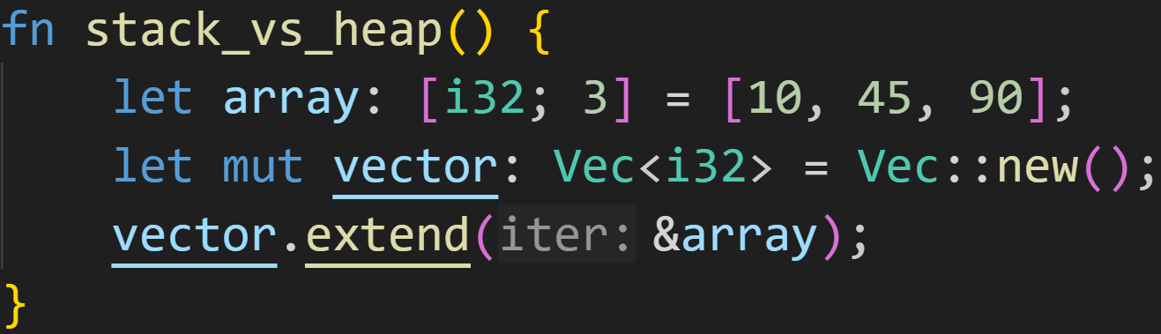
Arrays and Vectors

Slide 67
Arrays and Vectors
Stack
array | values | ???
 |  | ???
 |  | ???
vector | content | ???
 | capacity | ???
 | length | ???

Slide 68
Arrays and Vectors
Stack
array | values | 10
 |  | 45
 |  | 90
vector | content | ???
 | capacity | ???
 | length | ???

Slide 69
Arrays and Vectors
Stack
array | values | 10
 |  | 45
 |  | 90
vector | content | ???
 | capacity | 0
 | length | 0

Slide 70
Arrays and Vectors
Stack
array | values | 10
 |  | 45
 |  | 90
vector | content | 0xabc0
 | capacity | 4
 | length | 3
Heap
0xabc0 | 10
0xabc4 | 45
0xabc8 | 90
... | ...

Slide 71
Intermission - The vec![] macro
Using Vec::push(), we can add elements to a Vector

Slide 72
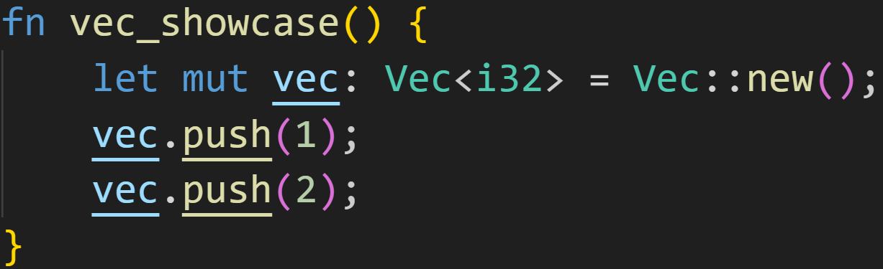
Intermission - The vec![] macro
Using Vec::push(), we can add elements to a Vector

Slide 73
Intermission - The vec![] macro
Using Vec::push(), we can add elements to a Vector
Methods will be covered later, but this puts a 1 and a 2 into the vector

Slide 74
Intermission - The vec![] macro
Using Vec::push(), we can add elements to a Vector
Because we modify the vector, the variable has to be mutable

Slide 75
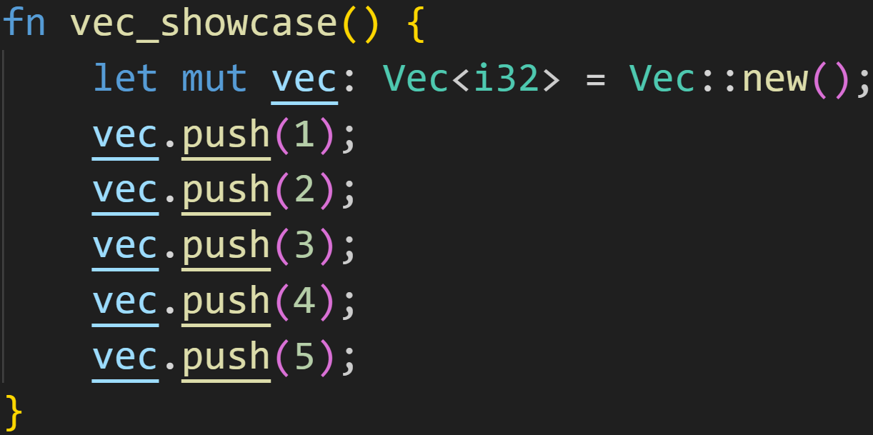
Intermission - The vec![] macro
Imagine you want to declare a Vector with 5 elements

Slide 76
Intermission - The vec![] macro
Imagine you want to declare a Vector with 5 elements
6 lines of code! That‘s a lot of work!
Now imagine declaring it with 10 elements!

Slide 77
Intermission - The vec![] macro
Imagine you want to declare a Vector with 5 elements
Introducing: The vec![] macro

Slide 78
Intermission - The vec![] macro
Imagine you want to declare a Vector with 5 elements
Introducing: The vec![] macro
Thanks to Rust‘s Trait System, Arrays and Vectors share a lot of similarities
Getting and setting elements...
Checking if an Array/Vector contains an element...

Slide 79
Intermission - The vec![] macro
Imagine you want to declare a Vector with 5 elements
Introducing: The vec![] macro
Thanks to Rust‘s Trait System, Arrays and Vectors share a lot of similarities
By using this macro, we add declaration to that list

Slide 80
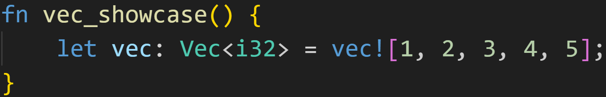
Intermission - The vec![] macro
Imagine you want to declare a Vector with 5 elements
Introducing: The vec![] macro
Thanks to Rust‘s Trait System, Arrays and Vectors share a lot of similarities
By using this macro, we add declaration to that list

Slide 81
Intermission - The vec![] macro
Imagine you want to declare a Vector with 5 elements
Introducing: The vec![] macro
Thanks to Rust‘s Trait System, Arrays and Vectors share a lot of similarities
By using this macro, we add declaration to that list
Create a Vector

Slide 82
Intermission - The vec![] macro
Imagine you want to declare a Vector with 5 elements
Introducing: The vec![] macro
Thanks to Rust‘s Trait System, Arrays and Vectors share a lot of similarities
By using this macro, we add declaration to that list
Fill with those values!
Create a Vector

Slide 83
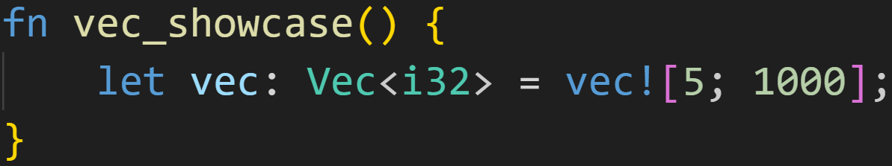
Intermission - The vec![] macro
Imagine you want to declare a Vector with 5 elements
Introducing: The vec![] macro
Thanks to Rust‘s Trait System, Arrays and Vectors share a lot of similarities
By using this macro, we add declaration to that list

Slide 84
Intermission - The vec![] macro
Imagine you want to declare a Vector with 5 elements
Introducing: The vec![] macro
Thanks to Rust‘s Trait System, Arrays and Vectors share a lot of similarities
By using this macro, we add declaration to that list
Create a Vector

Slide 85
Intermission - The vec![] macro
Imagine you want to declare a Vector with 5 elements
Introducing: The vec![] macro
Thanks to Rust‘s Trait System, Arrays and Vectors share a lot of similarities
By using this macro, we add declaration to that list
Create a Vector
Push a 5 ... 1000 times!

Slide 86
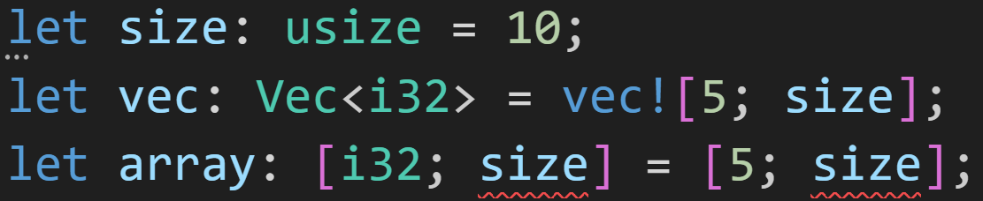
Intermission - The vec![] macro
Imagine you want to declare a Vector with 5 elements
Introducing: The vec![] macro
Thanks to Rust‘s Trait System, Arrays and Vectors share a lot of similarities
By using this macro, we add declaration to that list
vec![] has one benefit over Array declarations → The size argument can be dynamic!

Slide 87
Intermission - The vec![] macro
Imagine you want to declare a Vector with 5 elements
Introducing: The vec![] macro
Thanks to Rust‘s Trait System, Arrays and Vectors share a lot of similarities
By using this macro, we add declaration to that list
vec![] has one benefit over Array declarations → The size argument can be dynamic!
size is evaluated at runtime

Slide 88
Intermission - The vec![] macro
Imagine you want to declare a Vector with 5 elements
Introducing: The vec![] macro
Thanks to Rust‘s Trait System, Arrays and Vectors share a lot of similarities
By using this macro, we add declaration to that list
vec![] has one benefit over Array declarations → The size argument can be dynamic!
size is evaluated at runtime
needs to be known at compile time for Arrays

Slide 89
Intermission - The vec![] macro
Imagine you want to declare a Vector with 5 elements
Introducing: The vec![] macro
Thanks to Rust‘s Trait System, Arrays and Vectors share a lot of similarities
By using this macro, we add declaration to that list
vec![] has one benefit over Array declarations → The size argument can be dynamic!
Doesn‘t matter for vec![]
size is evaluated at runtime
needs to be known at compile time for Arrays

Slide 90
Arrays and Vectors
Thanks to Traits, the Syntax for getting and setting elements is the same for Arrays and Vectors

Slide 91
Arrays and Vectors
Thanks to Traits, the Syntax for getting and setting elements is the same for Arrays and Vectors
Indices are always of type usize

Slide 92
Arrays and Vectors
Thanks to Traits, the Syntax for getting and setting elements is the same for Arrays and Vectors
Indices are always of type usize
Arrays and Vectors are zero-indexed

Slide 93
Arrays and Vectors
Arrays and Vectors are zero-indexed

Slide 94
Arrays and Vectors
Arrays and Vectors are zero-indexed
Element at index 0 is 10

Slide 95
Arrays and Vectors
Arrays and Vectors are zero-indexed
Element at index 0 is 10
Element at index 1 is 45

Slide 96
Arrays and Vectors
Arrays and Vectors are zero-indexed
Element at index 0 is 10
Element at index 1 is 45
Element at index 2 is 90

Slide 97
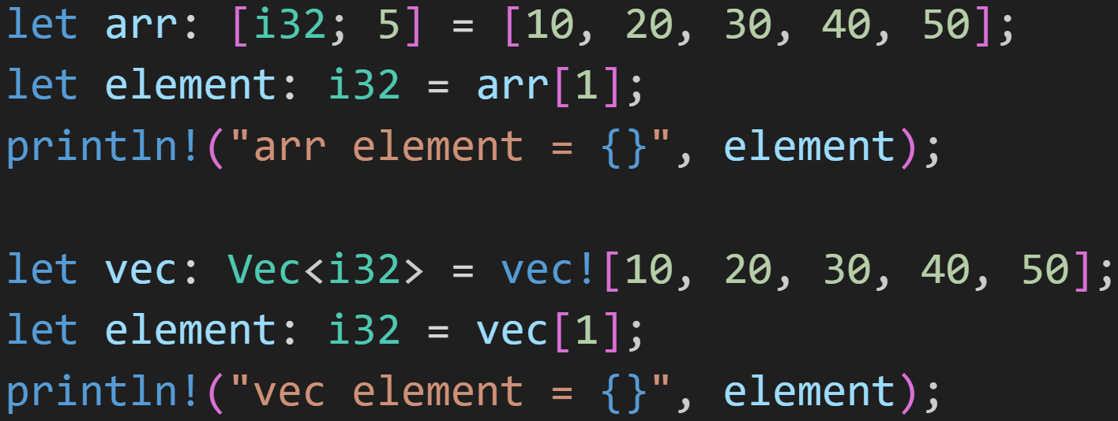
Arrays and Vectors

Slide 98
Arrays and Vectors
Get element at index 1
Get element at index 1

Slide 99
Arrays and Vectors
1/3
What does this print?
What does this print?

Slide 100
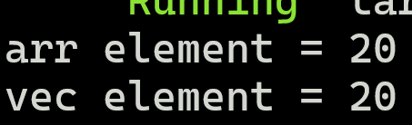
Arrays and Vectors
1/3
What does this print?
What does this print?

Slide 101
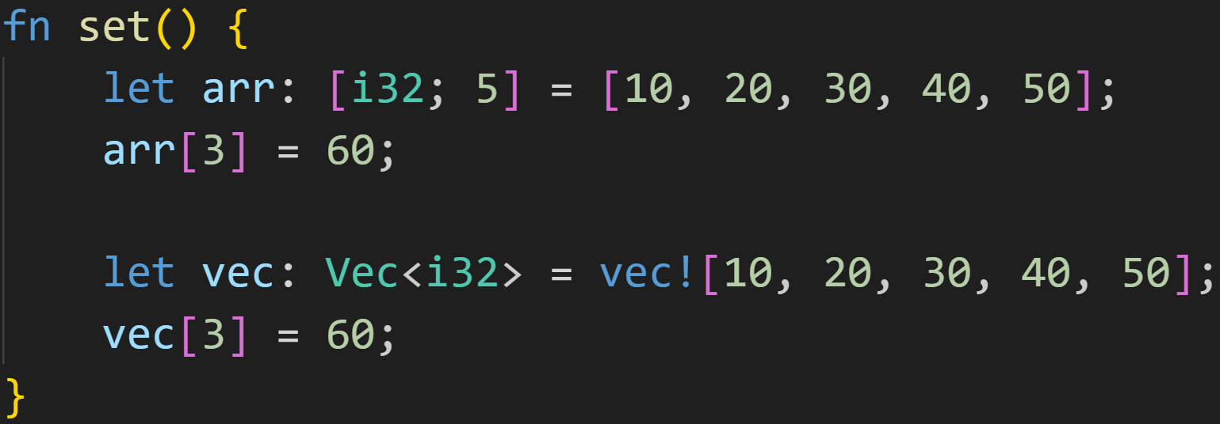
Arrays and Vectors

Slide 102
Arrays and Vectors
Set the element at index 3 to 60
Set the element at index 3 to 60

Slide 103
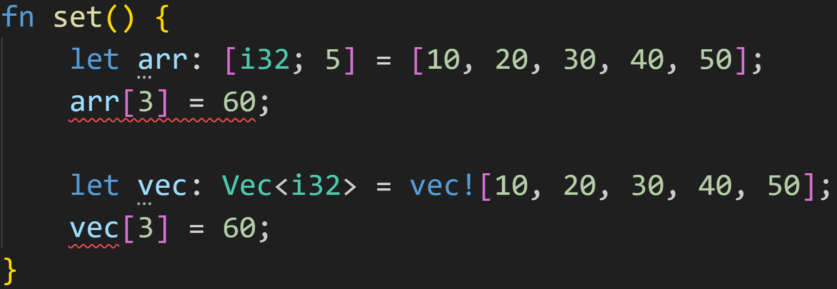
Arrays and Vectors
Doesn‘t work!
Doesn‘t work!

Slide 104
Arrays and Vectors
Variables are immutable, can‘t modify them!

Slide 105
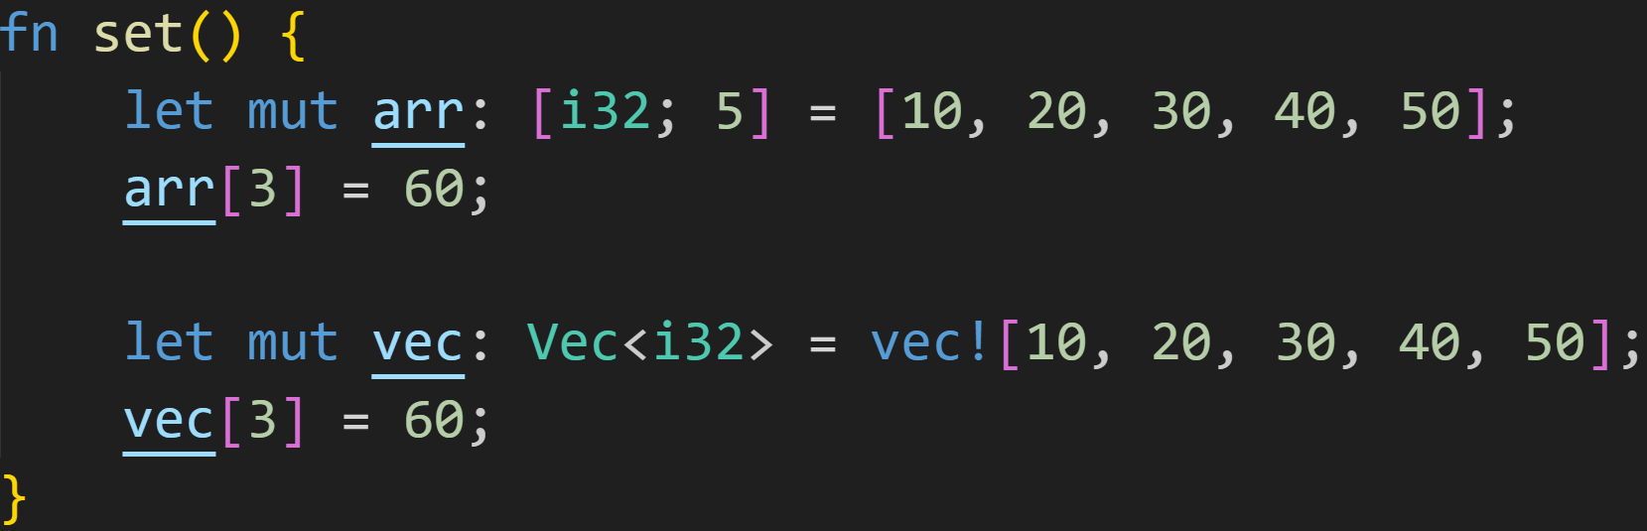
Arrays and Vectors

Slide 106
Arrays and Vectors
60
60

Slide 107
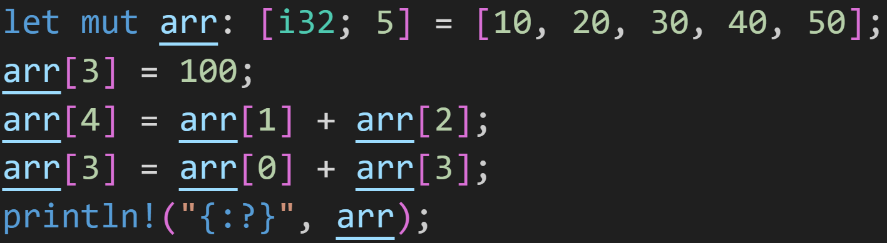
Arrays and Vectors
2/3

Slide 108
Arrays and Vectors
2/3
What does the array look like here?

Slide 109
Arrays and Vectors
2/3
100
What does the array look like here?

Slide 110
Arrays and Vectors
2/3
100
20
What does the array look like here?

Slide 111
Arrays and Vectors
2/3
100
20
30
What does the array look like here?

Slide 112
Arrays and Vectors
2/3
100
50
20
30
What does the array look like here?

Slide 113
Arrays and Vectors
2/3
110
50
10
100
What does the array look like here?

Slide 114

Arrays and Vectors
2/3
110
50
Result:

Slide 115
Arrays and Vectors
Arrays and Vectors come with many useful methods

Slide 116
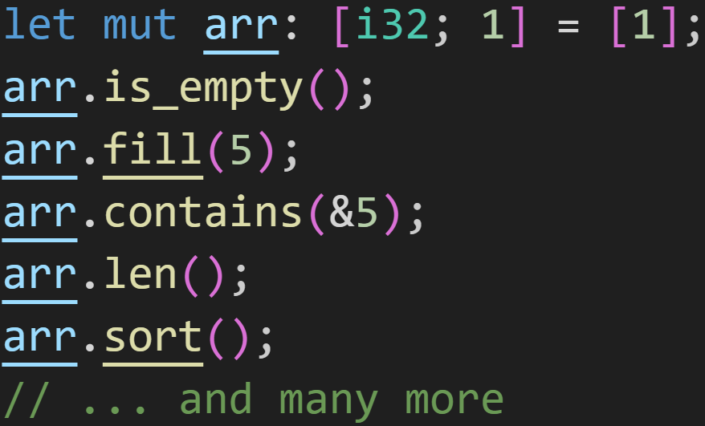
Arrays and Vectors
Arrays and Vectors come with many useful methods

Slide 117
Arrays and Vectors
Arrays and Vectors come with many useful methods
Are there any elements in our array?

Slide 118
Arrays and Vectors
Arrays and Vectors come with many useful methods
Are there any elements in our array?
Set every element in the array to the provided value

Slide 119
Arrays and Vectors
Arrays and Vectors come with many useful methods
Are there any elements in our array?
Set every element in the array to the provided value
Does the array contain the given value?

Slide 120
Arrays and Vectors
Arrays and Vectors come with many useful methods
Are there any elements in our array?
Set every element in the array to the provided value
Does the array contain the given value?
Get the size of our array (here: 1)

Slide 121
Arrays and Vectors
Arrays and Vectors come with many useful methods
Are there any elements in our array?
Set every element in the array to the provided value
Does the array contain the given value?
Get the size of our array (here: 1)
Sort the array (in place)

Slide 122
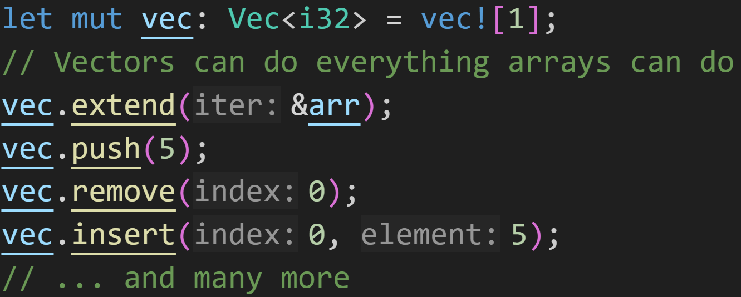
Arrays and Vectors
Arrays and Vectors come with many useful methods

Slide 123
Arrays and Vectors
Arrays and Vectors come with many useful methods
Push all elements of a collection into the vector

Slide 124
Arrays and Vectors
Arrays and Vectors come with many useful methods
Push all elements of a collection into the vector
Push a single element into the vector → inserts it at the end

Slide 125
Arrays and Vectors
Arrays and Vectors come with many useful methods
Push all elements of a collection into the vector
Push a single element into the vector
Remove the element at a given index → Shifts all values after it to the left

Slide 126
Arrays and Vectors
Arrays and Vectors come with many useful methods
Push all elements of a collection into the vector
Push a single element into the vector
Remove the element at a given index
Insert an element at a given index → Shifts all values after it to the right

Slide 127
Intermission - Exercise
Time for exercises!

Slide 128
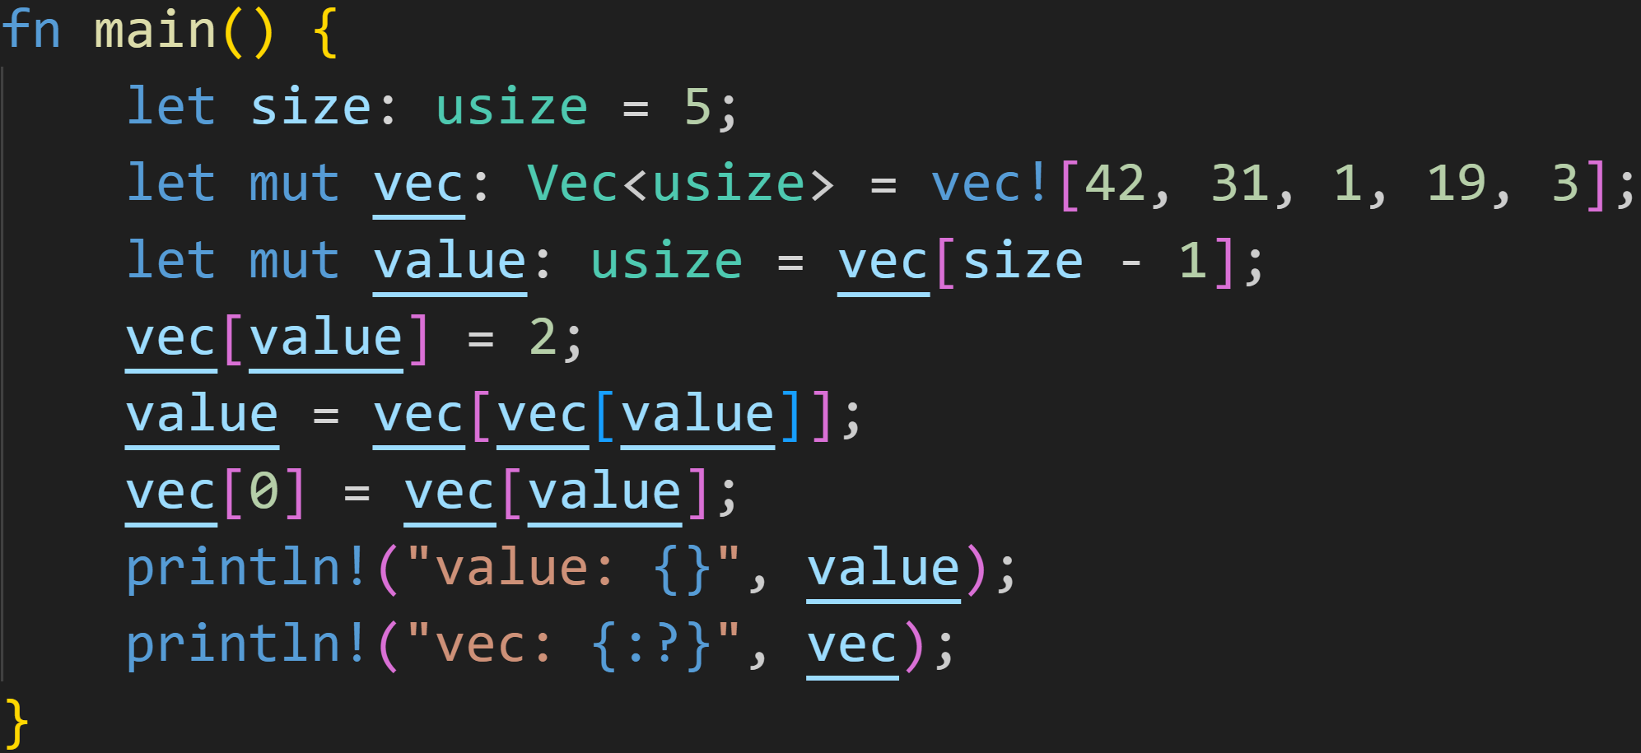
Intermission - Exercise
2/3

Slide 129
Intermission - Exercise
2/3
This code compiles.
What does it print in the end?

Slide 130
Intermission - Exercise
2/3
This code compiles.
What does it print in the end?
→ value = vec[4] = 3

Slide 131
Intermission - Exercise
2/3
This code compiles.
What does it print in the end?
→ value = 3 → vec[3] = 2

Slide 132
Intermission - Exercise
2/3
This code compiles.
What does it print in the end?
2
→ value = 3 → vec[3] = 2

Slide 133
Intermission - Exercise
2/3
This code compiles.
What does it print in the end?
2
→ value = vec[vec[value]]

Slide 134
Intermission - Exercise
2/3
This code compiles.
What does it print in the end?
2
→ value = vec[vec[value]] → vec[value] = 2

Slide 135
Intermission - Exercise
2/3
This code compiles.
What does it print in the end?
2
→ value = vec[vec[value]] → vec[value] = 2 → value = vec[2] = 1

Slide 136
Intermission - Exercise
2/3
This code compiles.
What does it print in the end?
2
→ value = 1

Slide 137
Intermission - Exercise
2/3
This code compiles.
What does it print in the end?
2
→ value = 1 → vec[0] = vec[1]

Slide 138
Intermission - Exercise
2/3
This code compiles.
What does it print in the end?
2
→ value = 1 → vec[0] = vec[1] = 31

Slide 139
Intermission - Exercise
2/3
This code compiles.
What does it print in the end?
31
2
→ vec[0] = 31

Slide 140
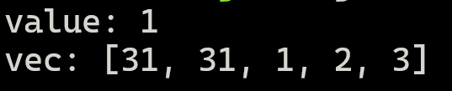
Intermission - Exercise
2/3
This code compiles.
What does it print in the end?
31
2
→ value = 1

Slide 141
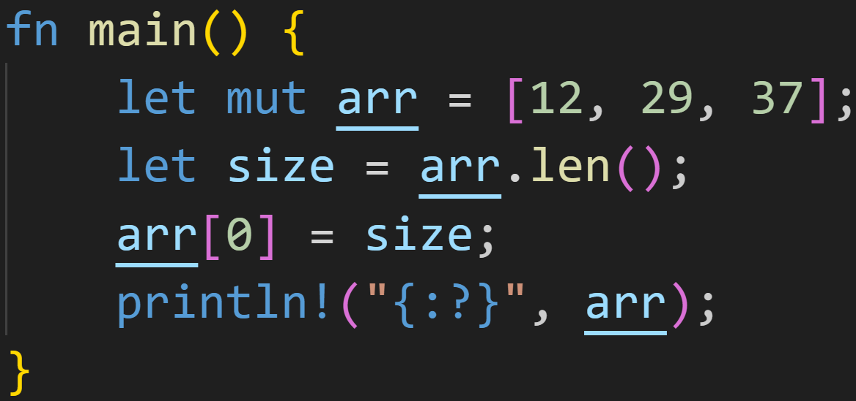
Intermission - Exercise
1/3

Slide 142
Intermission - Exercise
1/3
Does this compile?
If yes, what does it print?
What type does arr have?

Slide 143
Intermission - Exercise
1/3
Does this compile?
If yes, what does it print?
What type does arr have?
It does compile!

Slide 144
Intermission - Exercise
1/3
Does this compile?
If yes, what does it print?
What type does arr have?
len() returns a usize
→ size has type usize

Slide 145
Intermission - Exercise
1/3
Does this compile?
If yes, what does it print?
What type does arr have?
at least the first element of arr is of type usize
→ all elements are usize

Slide 146
Intermission - Exercise
1/3
Does this compile?
If yes, what does it print?
What type does arr have?
at least the first element of arr is of type usize
→ all elements are usize

Slide 147

Intermission - Exercise
1/3
Does this compile?
If yes, what does it print?
What type does arr have?
at least the first element of arr is of type usize
→ all elements are usize

Slide 148
Next time
Control Flow
Doing the same thing over and over again
loop
while
for

